Slide 1
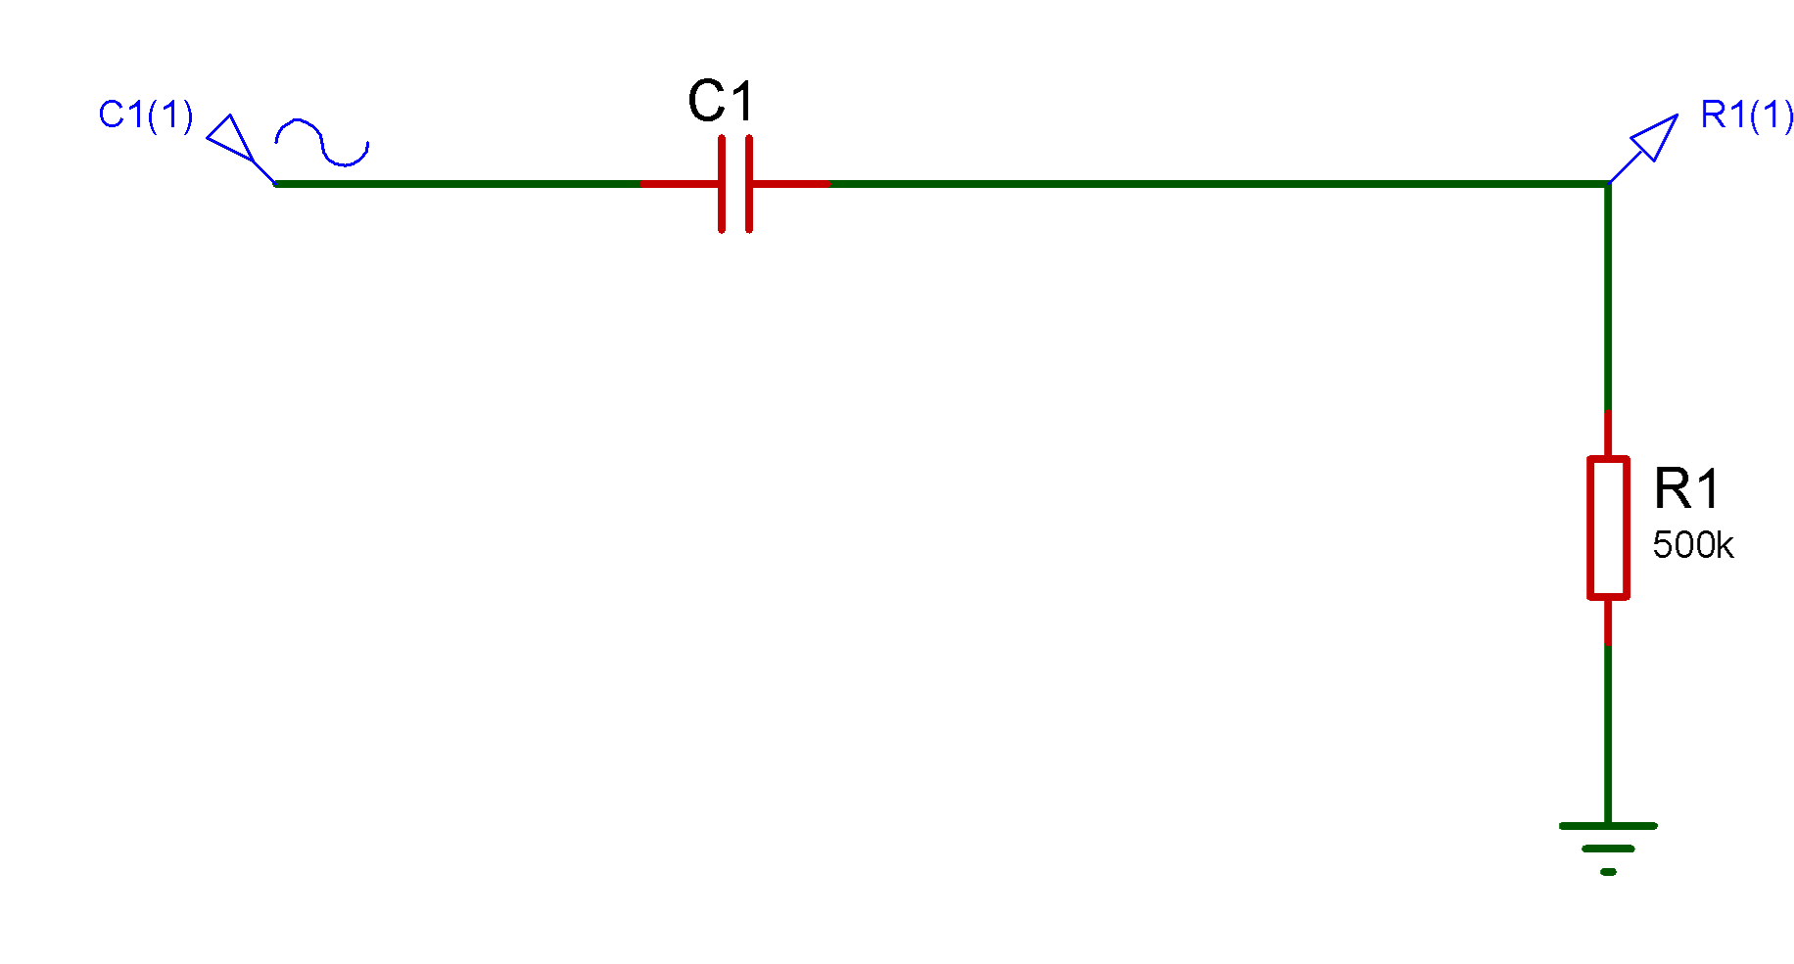
Buda Tech
Passive Filter Design
Suppose we have a circuit in which we want to filter out frequencies above 5,000Hz. Let’s also say that we have a 500kΩ resistor. We need to find the capacitor value to achieve the cutoff point of 5kHz

Slide 2
Passive Filter Design
Buda Tech
Suppose we have a circuit in which we want to filter out frequencies above 5,000Hz. Let’s also say that we have a 500kΩ resistor. We need to find the capacitor value to achieve the cutoff point of 5kHz
Data
Resistor = 500kΩ
capacitor = ?
Cutoff Frequency = 5KHz
.
The high pass filter only allows high frequency signals from its cut-off frequency, ƒc point to pass while blocking those any lower.

Slide 3




Buda Tech
Data
Resistor = 500kΩ
capacitor = ?
Cutoff Frequency = 5KHz
.
$$C =\frac{1}{2πRf_{c}}$$
$$C=\frac{1}{2 x π x 500k x 5KHz}$$
$$C=\frac{1}{2 x π x 500 x{10}^{3}x 5 x{10}^{3}}$$
$$C=\frac{1}{1.570796 x{10}^{10} }$$
$$C=63.7 x{ 10}^{12}=63.7pF$$

Slide 4



Buda Tech
Data
Resistor = 500kΩ
capacitor = ?
Cutoff Frequency = 5KHz
.
$$C =\frac{1}{2πRf_{c}}$$
$$C=\frac{1}{2 x π x 500k x 5KHz}$$
$$C=\frac{1}{2 x π x 500 x{10}^{3}x 5 x{10}^{3}}$$
$$C=\frac{1}{1.570796 x{10}^{10} }$$
$$C=63.7 x{ 10}^{12}=63.7pF$$

Slide 5



Buda Tech
This isn’t a common capacitor value so we can see what happens when we use the more common 62pF value with the formula.
Data
Resistor = 500kΩ
capacitor = 862pF
Cutoff frequency = ?
.
$$f_{c}=\frac{1}{2πRC}$$
$$f_{c}=\frac{1}{2 x π x 500k x 62p}$$
$$f_{c}=\frac{1}{2 x π x 62 x{10}^{−12}x 500 x{10}^{3}}$$
$$f_{c}{ C}_{}$$
$$f_{c}=\frac{1}{1.947787 x{10}^{−4} }$$
$$f_{c}=5134Hz=5.134kHz$$

Slide 6

FILTER $φ$ PHASE SHIFT
Buda Tech
wanted to check the phase angle at our cutoff point. We’ll use the following to find the phase shift in high-pass filters:
Data
Resistor = 500kΩ
capacitor = 62pF
fc = 5.13KHz.
$$φ=\tan^{−1}\left(2πfRC\right)$$
$$φ=\tan^{−1}\left(2πfRC\right)$$
$$φ=\tan^{−1}\left(2π x 5.13k x 500k x 62pF\right)$$

Slide 7
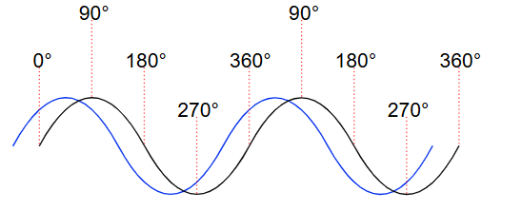
FILTER $φ$ PHASE SHIFT
Buda Tech
wanted to check the phase angle at our cutoff point. We’ll use the following to find the phase shift in high-pass filters:
Data
Resistor = 500kΩ
capacitor = 62pF
fc = 5.13KHz.
$$φ=\tan^{−1}\left(2πfRC\right)$$
$$φ=\tan^{−1}\left(2πfRC\right)$$
$$φ=\tan^{−1}\left(2π x 5.13k x 500k x 62pF\right)$$
$$φ=\tan^{−1}\left(2π x 5.13 x{10}^{3}x 500 x{10}^{3}x 62 x{10}^{−12}\right)$$
$$φ=\tan^{−1}\left(2π x 5.13 x{10}^{3}x 500 x{10}^{3}x 62 x{10}^{−12}\right)$$
$$φ=45°$$
$φ =\frac{45° xπ}{180°}$ = 0.7853radians

Slide 8
Buda Tech
Frequency Response Curve or Bode Plot of HPF
+20dB/decade
Gain in dB
3dB(45°)
Blocked
Allowed
Frequency Hz
fc
cut off frequency = 5.13KHz

Slide 9
FILTER $φ$ PHASE SHIFT
Buda Tech
Using the following we can find the phase angle of a set frequency in a low-pass filter
Data
Resistor = 500kΩ
capacitor = 62pF
fc = 5.13KHz.
$$φ={−tan}^{−1}\left(2πfRC\right)$$
$$φ=−\tan^{−1}\left(2πfRC\right)$$
$$φ={− tan}^{−1}\left(2π x 5.13k x 500k x 62pF\right)$$

Slide 10
FILTER $φ$ PHASE SHIFT
Buda Tech
Using the following we can find the phase angle of a set frequency in a low-pass filter
Data
Resistor = 500kΩ
capacitor = 62pF
fc = 5.13KHz.
$$φ={−tan}^{−1}\left(2πfRC\right)$$
$$φ=−\tan^{−1}\left(2πfRC\right)$$
$$φ={− tan}^{−1}\left(2π x 5.13k x 500k x 62pF\right)$$
$$φ=− \tan^{−1}\left(2π x 5.13 x{10}^{3}x 500 x{10}^{3}x 62 x{10}^{−12}\right)$$
$$φ={− tan}^{−1}\left(2π x 5.13 x{10}^{3}x 500 x{10}^{3}x 62 x{10}^{−12}\right)$$
$$φ=− 45°$$
$φ =\frac{45° xπ}{180°}$ = - 0.7853radians

Slide 11
Buda Tech
Frequency Response Curve or Bode Plot of HPF
Gain in dB
3dB(45°)
Allowed
Blocked
Frequency Hz
fc
cut off frequency = 5.13KHz
-20dB/decade

